Slide 1
Software Engineering & Project Project Management
Faculty of ECMS / School of Computer Science
Notes:
This PowerPoint has been created for you to customise for your course. It can be used for your first lecture with students and uploaded to your MyUni course.
When you have finished customising the slides save as a PowerPoint Show ( .PPS)
Show students where they can access this PowerPoint in the MyUni course.

Slide 2
Project Management
Lecture 2
Chapter 5, 25 (22, 23 in Edition 9)
in the course text book

Slide 3
Outline
Project Management
Project Organization
Meetings
Communication
Managing People
key issues of team working, including team composition,
team cohesiveness, team communications and team organization
Project Planning
Notes:
General welcome and introduction to the lecturing and tutoring staff on the course

Slide 4
Project Management
If there are many software engineers involved in a project, then their work must be coordinated and managed.
Primary job of project manager is to ensure job is done on time and within budget.
Planning
Documenting goals
Developing a schedule
Developing a budget
Notes:
General welcome and introduction to the lecturing and tutoring staff on the course

Slide 5
Project Management (cont.)
acquisition of resources
space
computing resources
materials
human resources
recruiting, hiring, training, rewarding, retaining, directing project members
execution of plan
monitoring progress
report writing and presentations
Many of the technical aspects of SE (e.g., modularity) also apply to management (e.g., assign responsibility for different tasks to different groups or engineers).
Notes:
General welcome and introduction to the lecturing and tutoring staff on the course

Slide 6
Project Organisation
Any organization has both a formal and an informal structure. The informal structure is whatever communication patterns happen to evolve.
A successful group needs:
A goal
A division of labour
A leader
The leader ensures that the group:
Works effectively
Has the resources it needs
Is well-motivated
Has few misunderstandings
And the group meets its goals
Notes:
General welcome and introduction to the lecturing and tutoring staff on the course

Slide 7
Project Organisation (cont.)
A group needs both technical and administrative leadership, which it might get from different people.
Large software projects should not be tackled by a single large team
Time spent in communication may exceed time spent programming.
Team size should not exceed about 8.
Break big projects down into sub problems
Small programming teams have a number of benefits:
Minimized communication problems
A team quality standard can be developed
Team members work together more closely
Egoless programming can be practised
Team members get to know each others work.
Notes:
General welcome and introduction to the lecturing and tutoring staff on the course

Slide 8
Small Teams
For small groups of roughly equal ability, projects can be handled in a democratic manner.
Members of the group divide the work among themselves
Each person would be responsible for one or more subsystem of the project
Code walkthroughs and design reviews would ensure that several members of the group understood the subsystem
If any member left the group, there would be at least one person who could take over the work
Internal squabbles can still occur
Democratic groups may need a leader to arbitrate over such disputes
Which person is leader may vary from time to time
Different group members may be responsible for leading certain aspects of the project
E.g. software validation leader, documentation leader, configuration management leader
May be responsible for coordinating these activities and setting up the standard processes to be used
DOES NOT mean they do all the work in the area they are coordinating
Notes:
General welcome and introduction to the lecturing and tutoring staff on the course

Slide 9
Peer Assessment
You are all required to conduct performance reviews or peer assessments for your fellow group members
Two kinds of peer assessments
Weekly mini peer assessments
Final peer assessments
Weekly peer assessments
Do not affect your final grade
Give the lecturers an indication of students who are struggling or not doing their share of work
Give students some feedback on their performance
Final peer assessments
Conducted at the end of the project
Determines how the group mark will be split
Notes:
General welcome and introduction to the lecturing and tutoring staff on the course

Slide 10
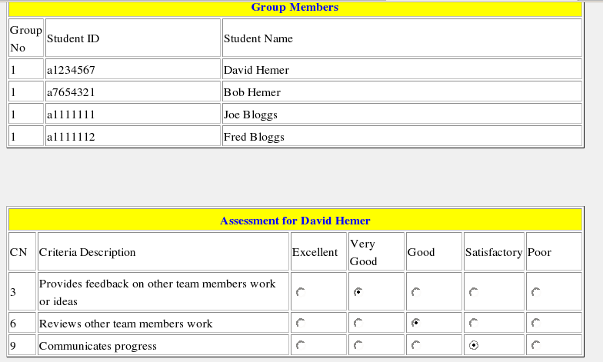
Example Peer Assessment Tool
Notes:
General welcome and introduction to the lecturing and tutoring staff on the course

Slide 11
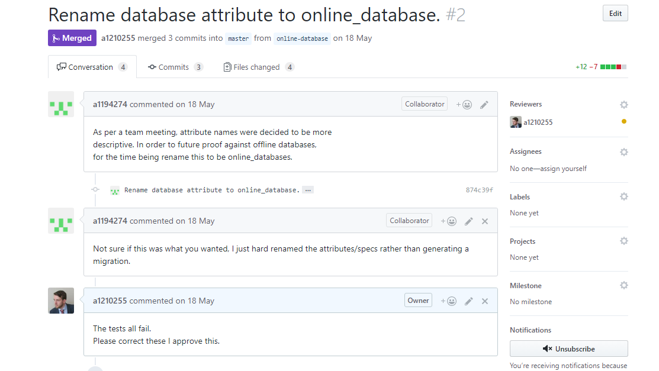
Example Peer Assessment Tool (cont.)
The Peer Review How-To Guide: https://www.lullabot.com/articles/the-peer-review-howto-guide
Notes:
Click on the image to open the pull request

Slide 12
Assessment Criteria
Weekly meetings
Attendance
Participation
Feedback on other team members work
Quality of Work
Produces work of high quality
Supports the development of group quality culture
Reviews other team members’ work
Task Allocation
Completes allocated tasks
Involved in task scheduling/planning
Communicates progress
Leadership
Engages in leadership role
Coordinates tasks under their management
Notes:
General welcome and introduction to the lecturing and tutoring staff on the course

Slide 13
Meetings
Many people view meetings as unproductive interludes which take them away from their real work.
A successful meetings should have six characteristics:
Clear purpose
Stick to the purpose
Agenda
Time frame
Participation
Minutes
There are two major categories of meetings:
Status meetings
Action meetings
Decision-making meetings
Brainstorming sessions
Notes:
General welcome and introduction to the lecturing and tutoring staff on the course

Slide 14
Status Meetings
Bring participants up-to-date on other peoples portions of the project.
Participants:
include those who need to make a report
those that need to hear it.
A meeting is only necessary when those reporting the progress and those hearing it need to interact, or it is faster than writing a short status report and circulating it.
Can this be handled better offline (e.g. via email)?
Agenda should include written reports from people on the work they are responsible for.
New business should be kept to a minimum.
Status meetings are typically short - ten to fifteen minutes.
So make sure everybody has read reports before meeting!
Notes:
General welcome and introduction to the lecturing and tutoring staff on the course

Slide 15
Brainstorming Sessions
Come up with a variety of possible solutions to a particular problem.
Participants:
those with something to contribute
includes junior staff and experienced designers.
Ideas one person suggests often inspire ideas in other people
Don’t throw an idea away too soon.
They may have good properties you want to exploit or they may stimulate other ideas.
People have to be encouraged to put their ideas forward:
Never dismiss or criticize a suggestion (until a separate evaluation phase later).
Before stating a new idea of your own, restate what the previous speaker said to their satisfaction.
Before stating a new idea of your own, find at least one good thing to state about the previous idea.
At the end of a brainstorming session, the ideas must be evaluated.
Notes:
General welcome and introduction to the lecturing and tutoring staff on the course

Slide 16
Decision Meetings
These meetings are fairly rare
decision usually falls under one persons area of authority and there is no need to agree on something.
Sometimes a decision is not clear-cut and the decision maker wants suggestions or advice from those affected by the decision.
A common type of decision-making meeting involves choosing between several alternatives.
Participants ought to be familiar with the alternatives before the meeting.
Notes:
General welcome and introduction to the lecturing and tutoring staff on the course

Slide 17
Communication
It is essential that you maintain regular communication between all members of the group
Failure to do so effectively will inevitably lead to trouble!
Regular group meetings (at least weekly) are a must, particularly status meetings
You should strive to have at least one meeting a week with all members present (even if it’s a short meeting)
Action meetings and brainstorming meetings need not involve all group members
Other lines of communication are also essential
Email
Private bulletin board
Notes:
General welcome and introduction to the lecturing and tutoring staff on the course

Slide 18
Workload
You should be spending 12 hours per week on the course (at least)
Potentially you could spend a lot more
Need to use your time wisely
Avoid long protracted meetings
Think about what can be achieved in the available time
You set the plan – you determine the goals
Be realistic
Revise your plan throughout the course
Aim for quality over quantity
Think about what process model best fits with your goals and resources
Remember the documentation (SRS, SPMP, SDD) forms a large chunk of the marks
Don’t underestimate how long it takes to integrate and test the system
Start learning the tools early – while the workload is lighter
Notes:
General welcome and introduction to the lecturing and tutoring staff on the course

Slide 19
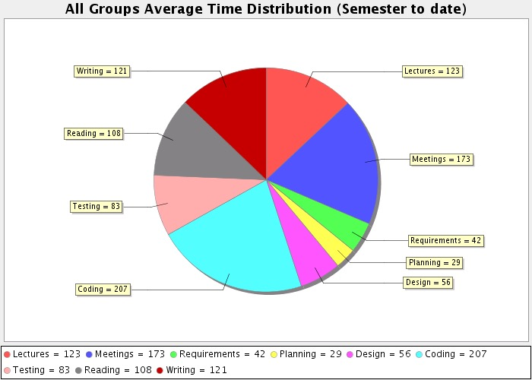
Time Distribution SEP 2007
Notes:
General welcome and introduction to the lecturing and tutoring staff on the course

Slide 20
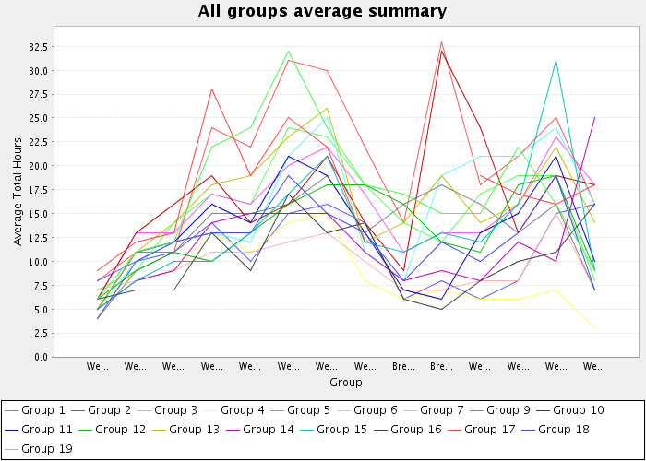
Weekly Load (Average) SEP 2007
Notes:
General welcome and introduction to the lecturing and tutoring staff on the course

Slide 21
Project Planning
Project plan includes
Intermediate goals (milestones)
Tasks
Resource allocation to tasks (people, equipment, cash,…)
Risk management
Identification
Mitigation
Control
This information is captured in the Software Project Management Plan (SPMP)
We have provided a template which you will need to use as the basis for your SPMP.
Start early !!
Notes:
General welcome and introduction to the lecturing and tutoring staff on the course

Slide 22
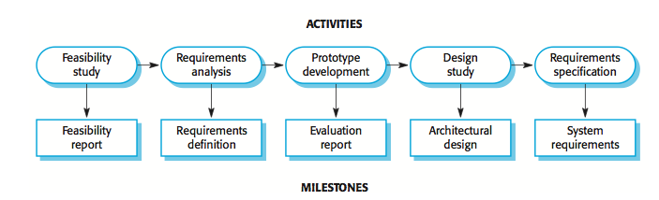
Milestones vs. Deliverables
Milestones are points in the schedule against which you can assess progress, for example, the handover of the system for testing.
Deliverables are work products that are delivered to the customer, e.g. a requirements document for the system.
Notes:
General welcome and introduction to the lecturing and tutoring staff on the course

Slide 23
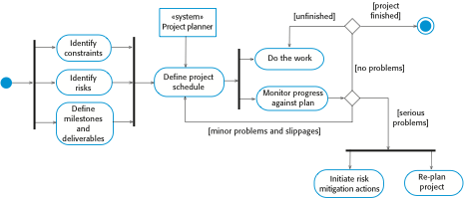
The project management process
Notes:
General welcome and introduction to the lecturing and tutoring staff on the course

Slide 24
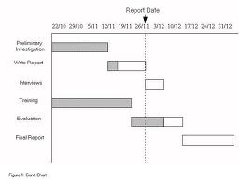
Schedule Representation
Graphical notations are normally used to illustrate the project schedule.
These show the project breakdown into tasks. Tasks should not be too small. They should take about a week or two.
Bar charts are the most commonly used representation for project schedules. They show the schedule as activities or resources against time.

Slide 25
Tasks, durations, and dependencies
Task | Effort (person-days) | Duration (days) | Dependencies
T1 | 15 | 10
T2 | 8 | 15
T3 | 20 | 15 | T1 (M1)
T4 | 5 | 10
T5 | 5 | 10 | T2, T4 (M3)
T6 | 10 | 5 | T1, T2 (M4)
T7 | 25 | 20 | T1 (M1)
T8 | 75 | 25 | T4 (M2)
T9 | 10 | 15 | T3, T6 (M5)
T10 | 20 | 15 | T7, T8 (M6)
T11 | 10 | 10 | T9 (M7)
T12 | 20 | 10 | T10, T11 (M8)
Notes:
General welcome and introduction to the lecturing and tutoring staff on the course

Slide 26
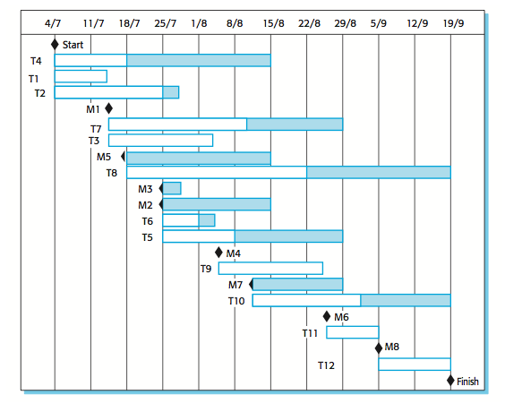
Activity bar chart
Notes:
General welcome and introduction to the lecturing and tutoring staff on the course

Slide 27
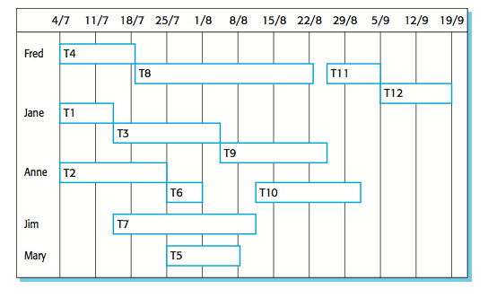
Staff allocation chart
Notes:
General welcome and introduction to the lecturing and tutoring staff on the course

Slide 28
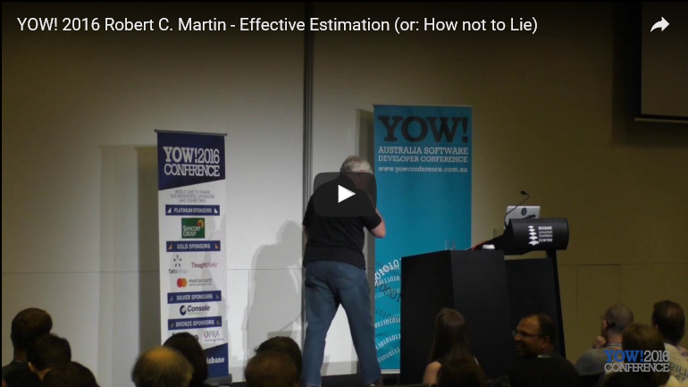
Side Note: Estimates
YOW! 2016 Robert C. Martin - Effective Estimation (or: How not to Lie)
https://www.youtube.com/watch?v=eisuQefYw_o

Slide 29
Relevance to your project
How are you going to plan and manage your project?
What tools will use to manage it?
How are you going to manage your team?
How are you going to manage your meetings, and communication between team members?
Motivation….
Task-oriented
Self-oriented
Interaction-oriented

